Slide 1

Welcome to
Aragon
Primary School

Slide 2
Meet the staff
Mrs Clare Ryder (Headteacher)
Mr Adam Gilbert (Deputy Headteacher)
Miss Pearce, Early Years Lead
Miss Smith – Nursery Class Teacher
Mrs Sutton & Mrs Salvador – NNEB EY’s TA
Miss Roberts – EY’s TA
Mrs Phillips & Mrs Bassey – EY’s TA

Slide 3
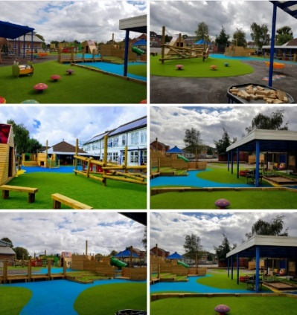
Meeting Us!
We would like to invite you all to our Stay & Play session on Friday 22nd July 2022 at 9.15am – 10.30am. This is a fantastic opportunity for you and your child to meet our Nursery staff and become familiar with our environment before starting with us after the summer holidays.
We would also love to come and meet you before the summer holidays and we have arranged a Home Visit for you, information found in your welcome book. This is another opportunity for us to come and meet you and your child in your home, a familiar environment.
We will also be available to answer any questions
you may have. Please do join us on these dates!

Slide 4
In September!
To ensure that the children feel safe, secure and happy starting with us, we allow for a settling in period at the start of the year.

Slide 5
This will be subject to change dependent on how well your child settles but we hope this gives you an indication of how your child’s first week will look.
AM children:
 | Day 1 | Day 2 | Day 3 | Day 4 | Day 5
Week 1 | 8.30am -9.30am (1 hour) | 8.30am -10am (1.5 hours) | 8.30am -10.30am (2 hours) | 8.30am -11am (2.5 hours) | 8.30am -11.30am (3 hours)
PM children:
 | Day 1 | Day 2 | Day 3 | Day 4 | Day 5
Week 1 | 1pm -2pm (1 hour) | 1pm -2.30pm (1.5 hours) | 12.30pm -2.30pm (2 hours) | 12.30pm -3pm (2.5 hours) | 12.30pm -3.30pm (3 hours)

Slide 6
If you have a 30 hour (all day) placement with us …
 | Day 1 | Day 2 | Day 3 | Day 4 | Day 5
Week 1 | 8.30am -9.30am (1 hour) | 8.30am -10am (1.5 hours) | 8.30am -10.30am (2 hours) | 8.30am -11am (2.5 hours) | 8.30am -11.30am (3 hours)
 | Day 6 | Day 7 | Day 8 | Day 9 | Day 10
*Week 2 | 8.45am -12.30pm (3.75 hours) | 8.45am -12.30pm (3.75 hours) | 8.45am -12.30pm (3.75 hours) | 8.45am -12.30pm (3.75 hours) | 8.45am -12.30pm (3.75 hours)
 | Day 11 | Day 12 | Day 13 | Day 14 | Day 15
Week 3 | 8.45am -1.45pm (5 hours) | 8.45am -1.45pm (5 hours) | 8.45am -1.45pm (5 hours) | 8.45am -3.15pm (6.5 hours) | 8.45am -3.15pm (6.5 hours)

Slide 7
A typical Nursery Day
AM Placement
8.30am – 8.45am: Your child’s day will start with a meet and greet by our friendly staff. After placing their belongings on their named peg, children are encouraged to self-register.
11.15am – 11.30am: You are given a 15-minute window to collect your child from nursery. Half-past eleven is the end of your child’s session.
PM Placement
12.30pm – 12.45pm: Your child’s day will start with a meet and greet by our friendly staff. After placing their belongings on their named peg, children are encouraged to self-register.
3.15pm – 3.30pm: You are given a 15-minute window to collect your child from nursery. Half-past three is the end of your child’s session.

Slide 8
30 hour (all day) Placement
8.30am – 8.45am: Your child’s day will start with a meet and greet by our friendly staff. After placing their belongings on their named peg, children are encouraged to self-register.
11.30am – 12 noon: Children are taken to the school hall to have their lunch. Hot school meal is on offer or you can bring a packed lunch box.
12 noon – 12.30pm: Children come back to the Early Years playground where they have playtime.
3pm – 3.15pm: You are given a 15-minute window to collect your child from nursery. Quarter past three is the end of your child’s session.

Slide 9
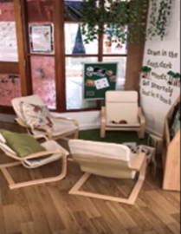
Throughout the Nursery session.
Your child will be encouraged to make their own choices and take part in adult led activities. Our environment is set up in a way that children’s development takes place through their natural curiosity.
We observe children individually, ensuring that each child has the opportunity to learn and develop a broad range of skills through play and discovery, based on their interests and level of development. We will track your child’s development through their ‘Learning Journal’ observations. You will be given the chance to contribute and view this book throughout the school year.
Children will participate in 2 short carpet sessions each day and these carpet sessions will focus on early reading, writing, maths and
topic skills.

Slide 10
School Uniform
They will need:
Navy blue jogging bottoms
White polo shirt
Navy sweatshirt with school logo*
Black shoes (preferably velcro, trainers are acceptable)
  The items with a logo on are available from yourschooluniform.com
Please ensure all items of clothing are named.
Notes:
Please ensure all clothes are named, it is very tricky working out whose is whose when you have 90 identical uniforms.

Slide 11
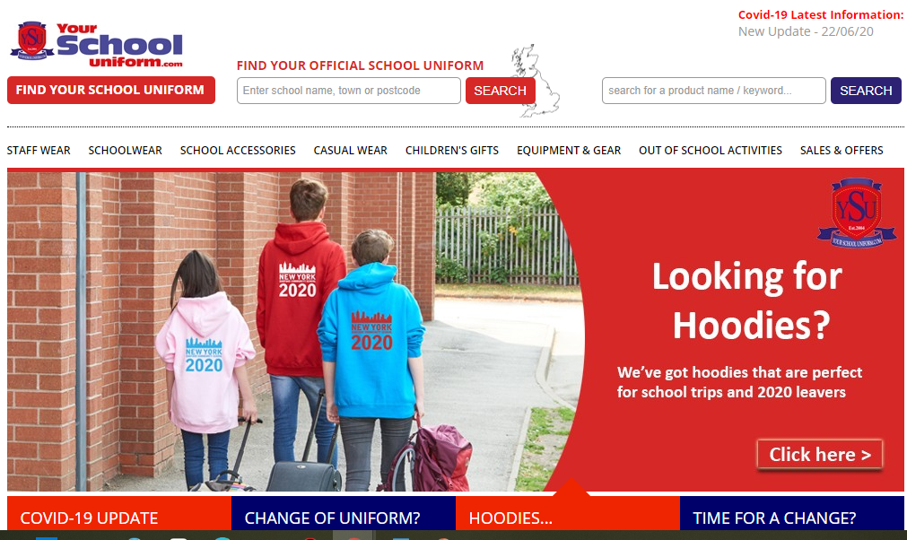
https://yourschooluniform.com/
Please order ASAP in order to receive it before September and ensure that it is delivered to your home address and not the school.

Slide 12
Health
Staff need to be aware of your child’s medical background, in particular any allergies (e.g. bee stings, dairy food), any dietary restrictions (e.g. vegetarian or Halal) and any medical conditions that are important for us to know (e.g. asthma or eczema).
Children can suddenly become ill and therefore it is important that we know we can contact you or another adult relative/friend at all times. Please ensure that the school is kept up to date with your contact details. If your child is unable to attend school due to illness, please telephone the school office to let us know.

Slide 13
As of September 2021, we have been following the new EYFS curriculum.
The Early Years Foundation Stage covers the first stage of a child’s care from birth to five years old. It sets the standards to ensure that all children learn and develop, as well as keeping them healthy and safe.
All schools and Ofsted registered early years providers in England must follow the EYFS.

Slide 14
Activities in our Nursery are very carefully planned and organised in order to provide a range of learning experiences.
Individual records (LEARNING JOURNALS) are kept by staff to record the activities your child participates in and undertakes, as well as their progress in specific skills.
Planning for each (WEEK/HALF TERM) is carried out using a topic-based approach, following the children’s interests and responding to specific events. Our topics follow a 2 year cycle and include All About Me, People Who Help Us, What a Wonderful World, Ready Steady Cook etc.
There are 7 Areas of Learning in the Early Years Foundation Stage (EYFS), which activities are planned around:
Communication and Language
Personal, Social and Emotional Development
Physical Development
Literacy
Mathematics
Understanding the World
Expressive Arts and Design
Throughout the EYFS, children will be working towards the Early Learning Goals. These describe the level of attainment expected at the end of your child’s Reception year in school.

Slide 15
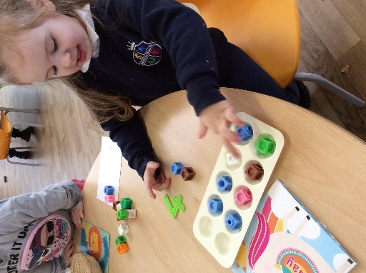
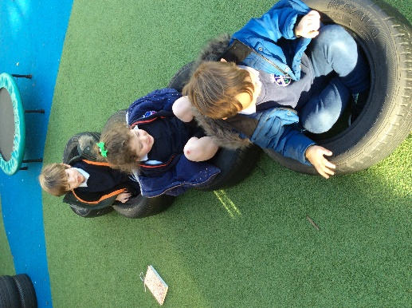
In Nursery, we focus hugely on the Prime Areas of our curriculum. We see these as the foundations of your child’s learning.

Slide 16
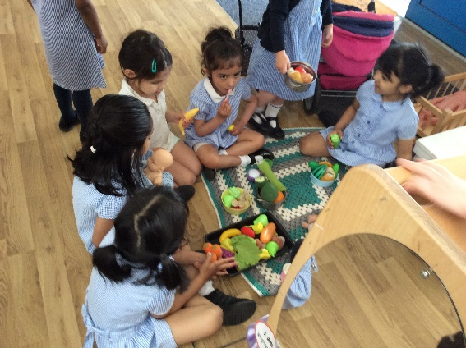
Communication and Language
The development of children’s spoken language underpins all seven areas of learning and development.
We comment on what children are interested in or doing, and echo back what they say with new vocabulary added. This will build children’s language effectively.
We read frequently to children, and engage them actively in stories, non-fiction, rhymes and poems, providing them with extensive opportunities to use and embed new words.
Through conversation, story-telling and role play, children share their ideas with support and modelling from us.

Slide 17
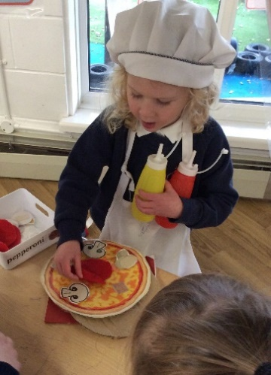
Personal, Social and Emotional Development
Children’s personal, social and emotional development (PSED) is crucial for children to lead healthy and happy lives, and is fundamental to their cognitive development.
Underpinning their personal development are the important attachments that shape their social world.
Strong, warm and supportive relationships with adults enable children to learn how to understand their own feelings and those of others.
Children should be supported to manage emotions, develop
a positive sense of self, set themselves simple goals, have
confidence in their own abilities, to persist and wait for what
they want.

Slide 18
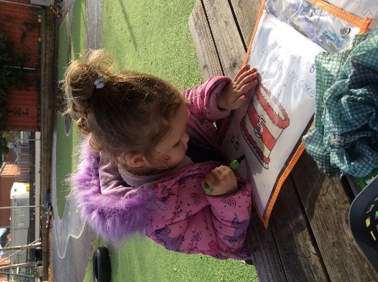
Physical Development
Physical activity is vital in children’s all-round development, enabling them to pursue happy, healthy and active lives.
By creating games and providing opportunities for play both indoors and outdoors, adults can support children to develop their core strength, stability, balance, spatial awareness, co-ordination and agility.
Fine motor control and precision helps with hand-eye co-ordination which is later linked to early literacy.
Repeated and varied opportunities to explore and play with small world activities, puzzles, arts and crafts and the practise of using small tools, with feedback and support from adults, allow children to develop proficiency, control and confidence.

Slide 19
We must also support children in four the specific areas, which are:
Literacy – name writing, Phonics – sound discrimination, Mark making – giving meaning to their marks, Talking about stories and pictures – re-tell key parts, join in with repeated refrains, anticipate what might happen next.
Mathematics - Varied counting experiences – real-life examples to develop number skills: reciting, counting objects / actions 1:1, beginning to match and recognise numerals. Mathematical language and concepts through play: big / small / round / heavy / light / tall / short / next.
Understanding the World - Sharing experiences about home and family. talking about the world around us: the weather, growing seeds, experimenting with materials and objects
Expressive Arts and Design – Art: using and exploring various media, materials and techniques, Drama: imaginative play, role-play themes, dressing-up, Dance & Music: listen and respond to different music, making our own music! Singing and rhyme times.

Slide 20
Learning Journals.
Throughout the year, staff will record your child’s learning in a book called a ‘LEARNING JOURNAL.’ This will form a unique record of your child’s learning and development. It will contain samples of work, photographs and staff observations. These books enable staff to track your child’s progress and attainment, and also plan future activities.
SeeSaw – Our Online Learning Platform: We will create a secure account, where we will upload photographs and videos relating to your child’s time with us. As a parent this allows you to view exciting achievements via a computer or smart phone and you can also contribute your own videos, photographs and posts. This is also where we communicate key and important dates for your diary. More information to follow at a later date.

Slide 21
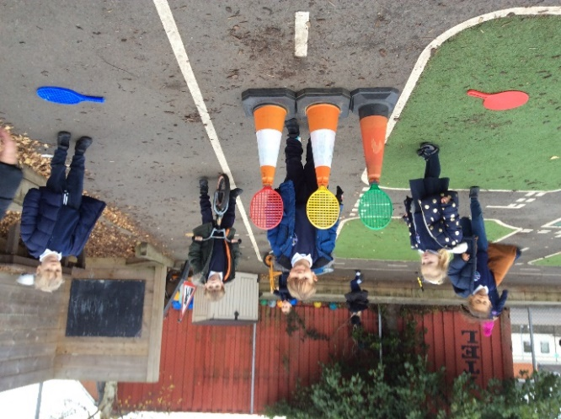
Home Learning.
To enrich your child’s education, we encourage …
Pleasure for Reading: Every Friday your child will be given the opportunity to choose a story book from our book box to share at home with you. This is a book for you to share with them to encourage a love for reading.
SeeSaw: Throughout each half term we will upload challenges for you and your child to complete together.

Slide 22
What you can do?
Encourage your child to begin to dress and undress themselves (finding their shoes, pulling their trousers up, attempting to put their coats on).
Ensure your child wears clothes and shoes which are easy to put on and off.
Encourage your child to drink from a cup without a lid, and to use a drink carton with straw.
Support your child to become fully potty trained before they are three.
Encourage independence whenever you can (hand washing, putting toys away, selecting resources, choosing the snack they want).

Slide 23
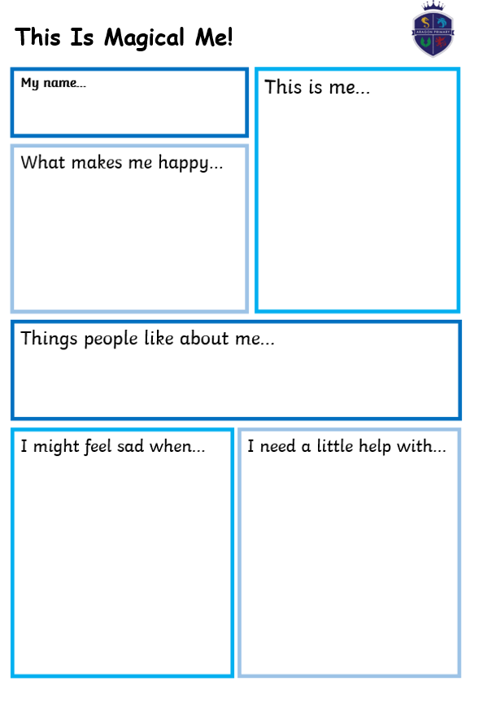
Notes:
Under normal circumstances, we would have arranged a Home Visit to meet you in your home and we would have organised a time for you to come into school to meet us and see your classroom. However, in order for us to get to know you a little bit more, we would love for you to complete our One Page Profile. This gives us a snapshot of your child.
You can include photographs, drawn pictures etc.
We will then spend the first 2 weeks sharing these with your child as a way for us to get to know them.
Please return these to me via email or in the school office.

Slide 24
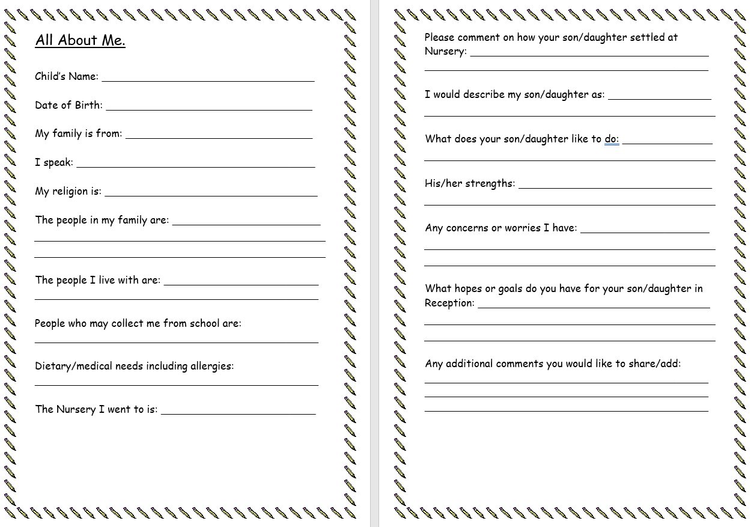

Slide 25
Any Questions?
Thank you for coming!
Notes:
Andrea

