Slide 1

Welcome to
Aragon
Primary School
Notes:
A warm welcome to Aragon Primary School, the Executive Head teacher, Associate Head teacher and myself are very pleased that your child will be taking their first steps into their education here at Aragon.
It is lovely to see so many of you here online, I recognise many faces. Please bear with us, as this is a very different way to hold our meetings.
Here at Aragon, we strongly believe in developing good relationships with parents/carers and we look forward to working together with you to support your child in their learning journey.

Slide 2
Meet the staff
Mrs Clare Ryder (Headteacher)
Mr Adam Gilbert (Deputy Headteacher)
Miss Pearce, Early Years Lead - (RP)
Mrs Curl – (RC)
Miss Thompstone - (RT)
Miss O’Sullivan – SENCo
Notes:
Let’s introduce the staff…..
I am Nicola Pearce and I am the Early Years lead here at Aragon, and I am also class based so I will be the Class Teacher in Beatrix Potter class also known as RP.
We then have Amanda Curl who will be the Class Teacher in Dr Seuss class also known as RC.
We also have Lauren Thompstone who will be the Class Teacher in AA Milne class also known as RT.
We also have 3 Teaching Assistants working in Reception, they are Lucy Grimes, Caroline McMahon and Nina Roberts.
I would also like to introduce you to Katie O’Sullivan who is our Nursery Lead but also our SENCo. --info

Slide 3
Meeting Us!
We would like to invite you all to our Stay & Play sessions on Wednesday 22nd June (for children who already attend our Nursery) and Thursday 23rd June (for children who attend other nursery settings).
For all of the children coming from an outside Nursery, we would love to come and meet you and we will therefore be arranging a Home Visit. This is an opportunity for 2 members of our team to come and visit you and your child in your own house, a familiar environment, where we can get to know you a little more.
We will also be available to answer any questions you may have. Please do join us on these dates!

Slide 4
In September!
To ensure that the children feel safe, secure and happy starting with us, we allow for a settling in period at the start of the year.
For the first week, the proposed times will be:

Slide 5
Friday 2nd September 2022 | INSET Day
Monday 5th September 2022 | Stay & Play session. A chance to meet the Reception Team and spend some time with your child in their new classroom and outside area. | RP: 9am – 10am RC: 10.15am – 11.15am RT: 11.30 – 12.30pm
Tuesday 6th September 2022 | Children will be dropped off and collected from the Reception Gate. | 8.45 – 11.45am
Wednesday 7th September 2022 | Children will be dropped off and collected from the Reception Gate. | 8.45 – 11.45am
Thursday 8th September 2022 | Children will be dropped off and collected from the Reception Gate. Children will stay for lunch. | 8.45am – 12.30pm
Friday 9th September 2022 | Children will be dropped off and collected from the Reception Gate. Children will stay for lunch. | 8.45am – 12.30pm
Monday 12th September 2022 | Children will be dropped off and collected from the Reception Gate. Children will stay for lunch. | 8.45am – 2pm
From Tuesday 13th September 2022 | Children will stay all day. Children will be dropped off & collected at Reception Gate. | 8.45am – 3.20pm
Notes:
These are the plans that we are hoping to follow in September:
To support the children with settling in they will start for the first few days part-time.
These dates can all be found on our website and I will email them out to you.
There will be a different collection point (at the front of the school) but staff will guide you and direct you on the day.
For the first two days they will not have lunch but from Thursday they will.
From Monday 14th September you will need to collect your child from the gate (where you drop your child off).
Unless the Government Guidelines change and you hear from us, please follow this timetable in September.

Slide 6
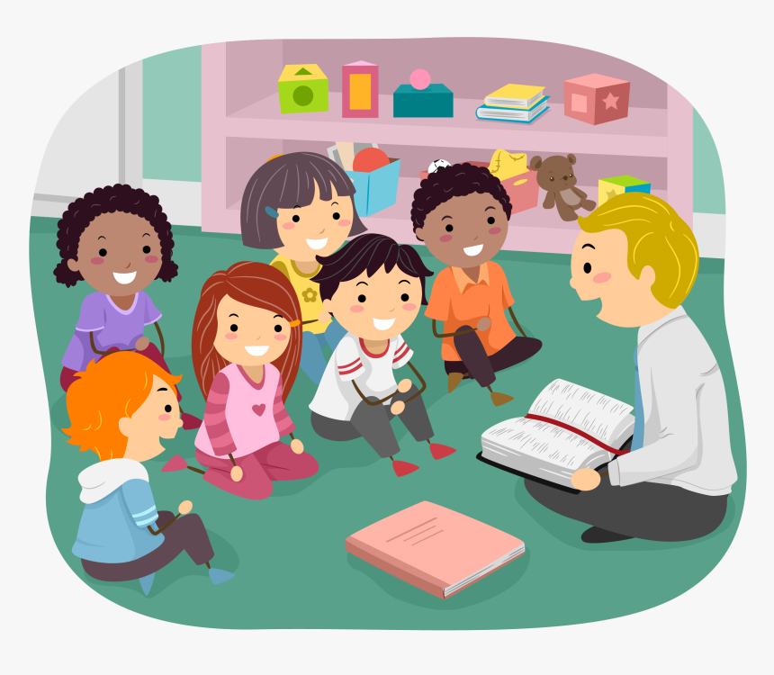
A Typical School Day
8.45am-3:20pm
Registration & Assembly
Carpet Session – Phonics
Busy Time/ adult focus activity (reading based)
Carpet Session – Maths Meeting (looking at the date/weather/new maths skills) & Maths Carpet Session
Busy Time/ adult focus activity (maths based)
Lunch
Topic and Busy Time/adult focus activity
Story/Rhyme Time
Notes:
The first school bell will go at 8.45 this allows you 10 minutes to get into school with the official school day starting at 8.55
Every school day is different, however within the day they are taught: literacy, maths, phonics, mental maths, topic and group work.
Children are encourage to eat fruit which is supplied to the school.
Children are entitled to free milk up until the age of five. This must be applied for online and there is a small charge for milk after they have turned five.
Please provide your child with a water bottle, no juice or squash.
School newsletters are issued via parent mail. We will give you details of how parent mail works once your child has started in September. We will also be using the online learning platform called Seesaw (which I know some of you are already familiar with).

Slide 7
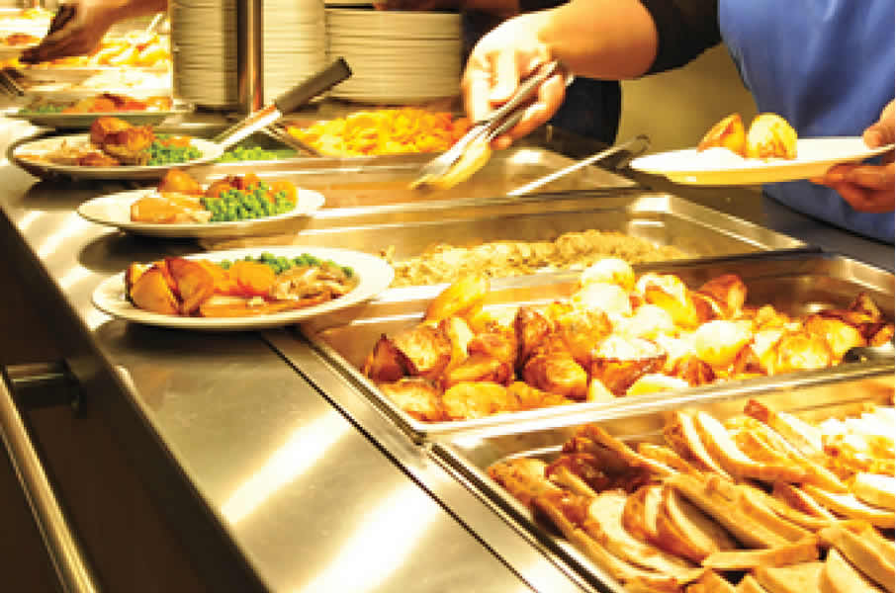
Lunch
Every child in Reception, Year 1 and Year 2 is entitled to a free school meal.
All of the children in Reception will be having a school meal.
This is a great opportunity for the children to try new food and develop their fine motor skills using cutlery.
All children in Reception will receive a FREE PIECE OF FRUIT/HEALTHY SNACK during the day.
The children are also entitled to a free carton of milk each day, until the age of 5 years. However, you must complete a milk form to receive this.
Please provide a clearly named water bottle for your child to have access to at all times.

Slide 8
School Uniform
They will need:
  Navy Blue Trousers
  Kilt* / Dress / Blue Gingham Summer Dress (for girls)
  Navy Jumper/Cardigan* with School Logo
  White Polo Shirt
  White or Navy Socks or Tights
  Black shoes
  The items with a logo on are available from yourschooluniform.com
  *Please buy a book bag and PE kit according to the house team colour your child has been allocated.
You will be informed in September which day is PE day.
Please ensure all items of clothing are named.
Notes:
Please ensure all clothes are named, it is very tricky working out whose is whose when you have 90 identical uniforms.

Slide 9
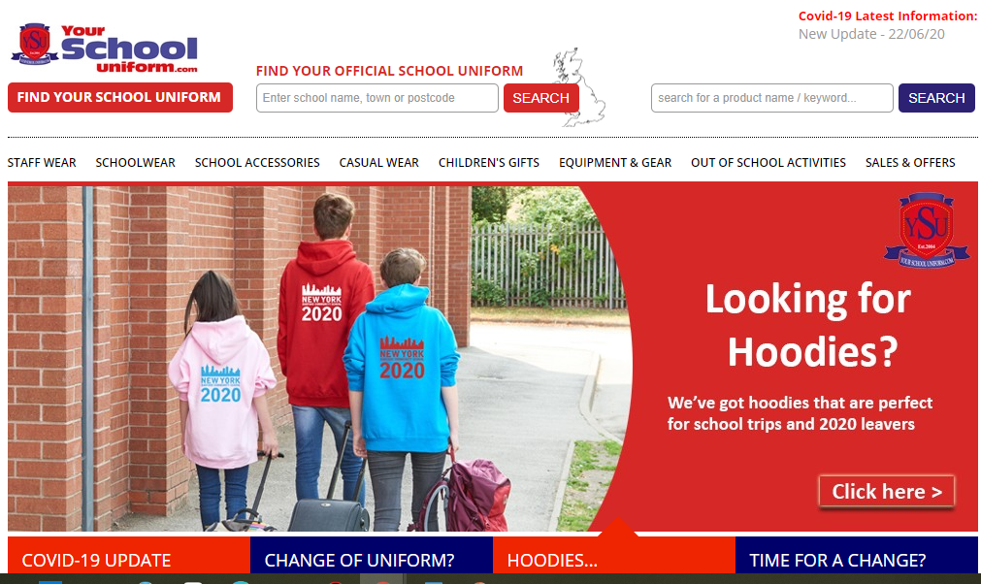
https://yourschooluniform.com/
Please order ASAP in order to receive it before September and ensure that it is delivered to your home address and not the school.

Slide 10
Health
Staff need to be aware of your child’s medical background, in particular any allergies (e.g. bee stings, dairy food), any dietary restrictions (e.g. vegetarian or Halal) and any medical conditions that are important for us to know (e.g. asthma or eczema).
Children can suddenly become ill and therefore it is important that we know we can contact you or another adult relative/friend at all times. Please ensure that the school is kept up to date with your contact details. If your child is unable to attend school due to illness, please telephone the school office to let us know.

Slide 11
As of September 2021, we have been following the new EYFS curriculum.
The Early Years Foundation Stage covers the first stage of a child’s care from birth to five years old. It sets the standards to ensure that all children learn and develop, as well as keeping them healthy and safe.
All schools and Ofsted registered early years providers in England must follow the EYFS.

Slide 12
Activities in our Reception classes are very carefully planned and organised in order to provide a range of learning experiences.
Individual records (LEARNING JOURNALS) are kept by staff to record the activities your child participates in and undertakes, as well as their progress in specific skills.
Planning for each (WEEK/HALF TERM) is carried out using a topic-based approach, following the children’s interests and responding to specific events. Our topics follow a 2 year cycle and include All About Me, People Who Help Us, What a Wonderful World, Ready Steady Cook etc.
There are 7 Areas of Learning in the Early Years Foundation Stage (EYFS), which activities are planned around:
Communication and Language
Personal, Social and Emotional Development
Physical Development
Literacy
Mathematics
Understanding the World
Expressive Arts and Design
Throughout the EYFS, children will be working towards the Early Learning Goals. These describe the level of attainment expected at the end of your child’s Reception year in school.

Slide 13
Within the first few weeks of your child starting Reception with us, we will give you more information about our Early Years Curriculum.

Slide 14
Learning Journals.
Throughout the year, staff will record your child’s learning in a book called a ‘LEARNING JOURNAL.’ This will form a unique record of your child’s learning and development. It will contain samples of work, photographs and staff observations. These books enable staff to track your child’s progress and attainment, and also plan future activities.
SeeSaw – Our Online Learning Platform: We will create a secure account, where we will upload photographs and videos relating to your child’s time with us. As a parent this allows you to view exciting achievements via a computer or smart phone and you can also contribute your own videos, photographs and posts. This is also where we communicate key and important dates for your diary. More information to follow at a later date.

Slide 15
Home Learning.
To enrich your child’s education, we set the expectation that …
Phonics Homework: A weekly activity that directly supports what we have been learning in our Phonics sessions that week.
Online Reading e - book: This is a celebration read of the story that they have been reading in school with their Class Teacher that week. We expect this to happen on a daily basis.
Pleasure for Reading: Every Friday your child will be given the opportunity to choose a story book from our book box to share at home with you. This is not for your child to read but for you to share with them to encourage a love for reading.
SeeSaw: Throughout each half term we will upload challenges for you and your child to complete together.

Slide 16
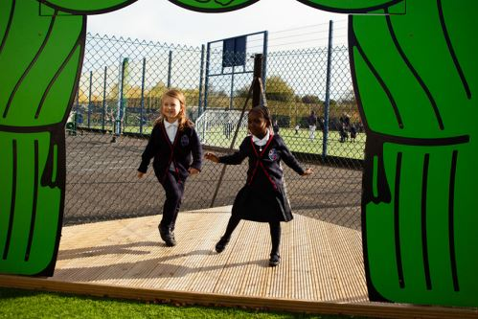
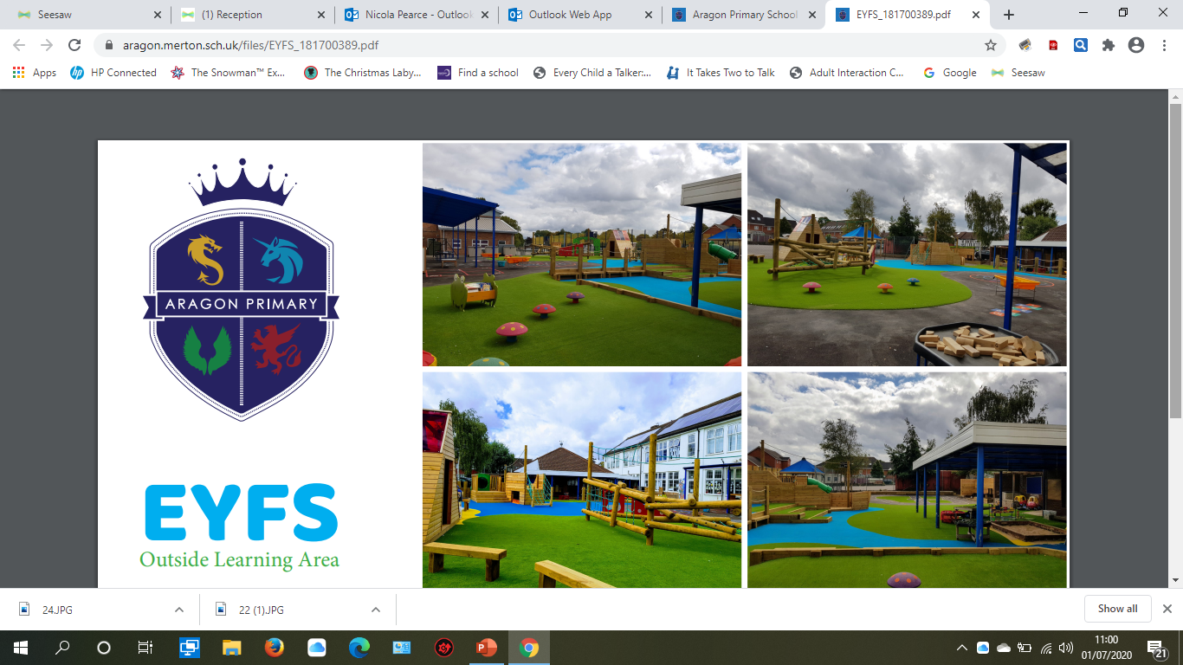
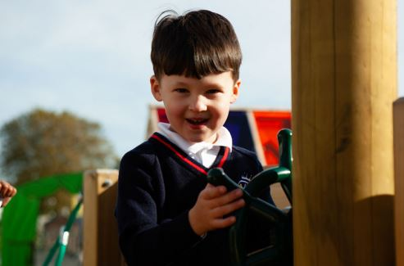
Early Years Outside Area.
In Reception we free-flow outside everyday regardless of the weather.
Our outside area is a continuation of our inside classrooms and ensures provision of all areas of learning.
With this in mind, it is essential children have a named coat at school everyday.

Slide 17
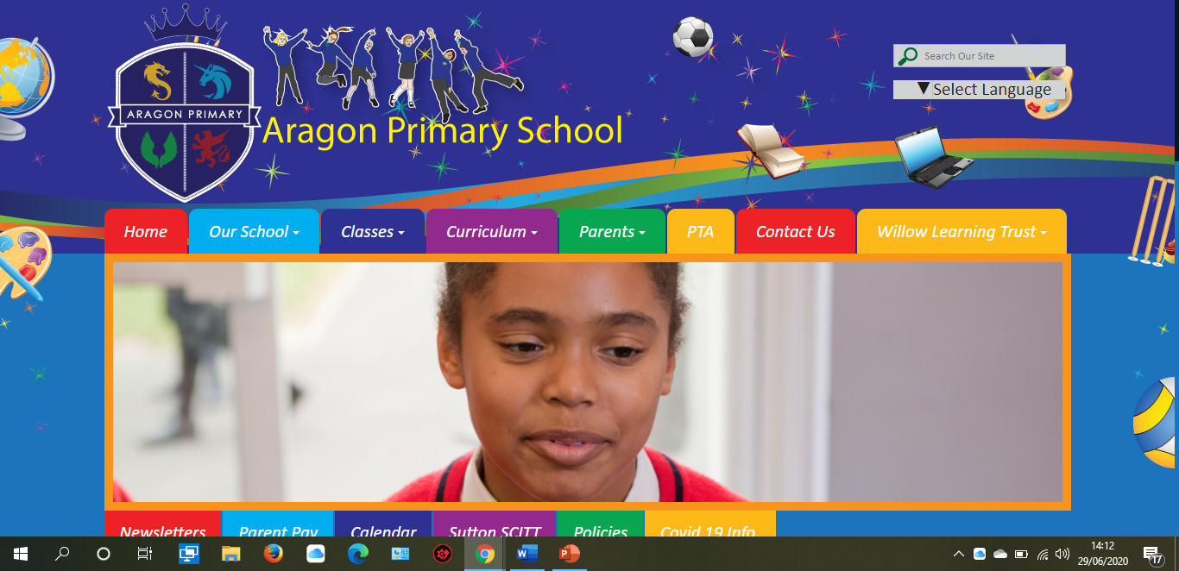
https://www.aragon.merton.sch.uk/

Slide 18
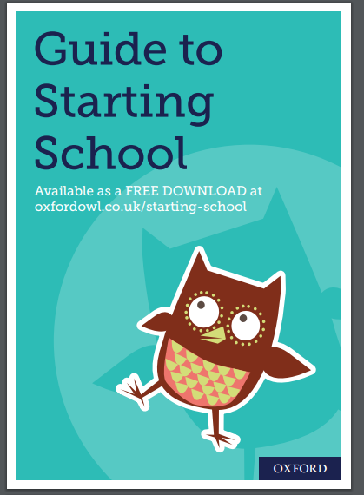
https://cdn.oxfordowl.co.uk/2018/06/27/15/30/15/280/Oxford_Owl_Starting_School_Guide_2018.pdf

Slide 19
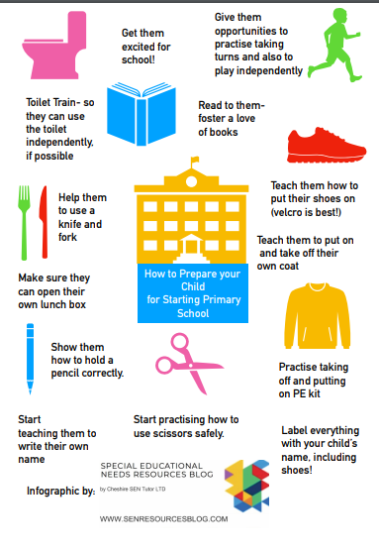

Slide 20
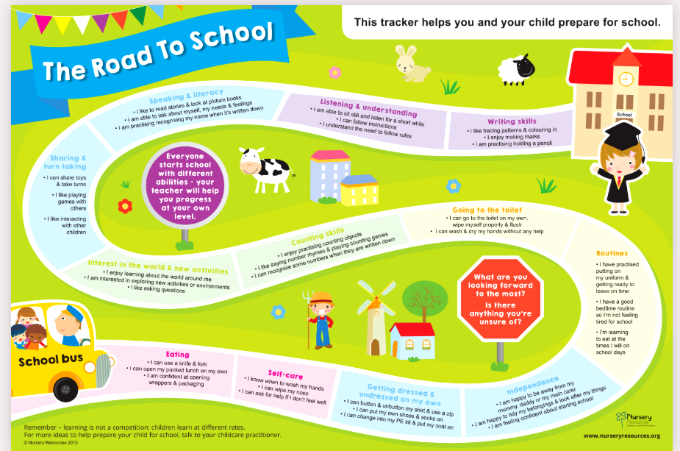

Slide 21
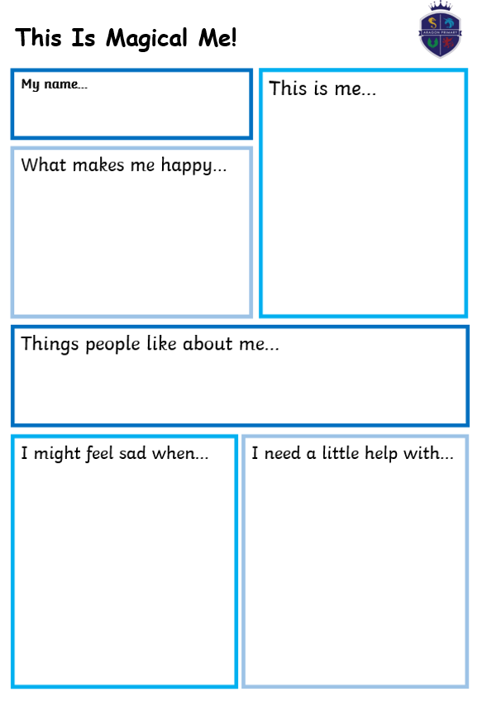
Notes:
Under normal circumstances, we would have arranged a Home Visit to meet you in your home and we would have organised a time for you to come into school to meet us and see your classroom. However, in order for us to get to know you a little bit more, we would love for you to complete our One Page Profile. This gives us a snapshot of your child.
You can include photographs, drawn pictures etc.
We will then spend the first 2 weeks sharing these with your child as a way for us to get to know them.
Please return these to me via email or in the school office.

Slide 22
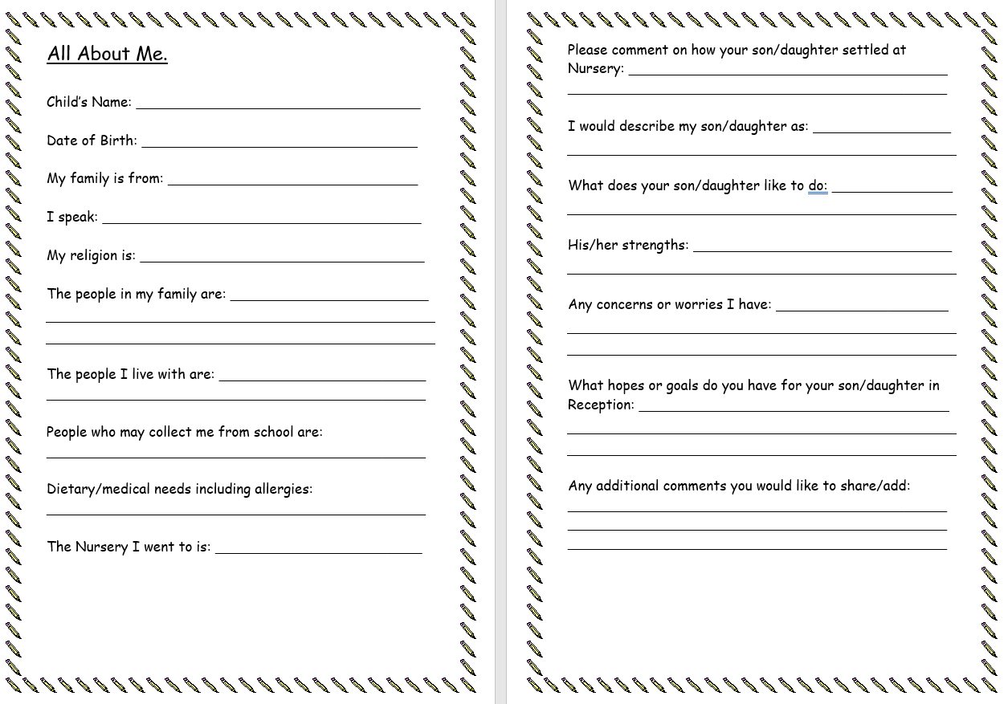

Slide 24
Any Questions?
Thank you for joining us!

